Slide 1

Target!
Can you make 10?

Slide 2
Directions
In order to play the game you must find “Slide Show” in the top navigation. Click on slide #3 with the target and select “From Current Slide” in order to present/display the game.
Click on one of the colored spots on the target board. It will bring you to an equation where the sum is always 10. Click on the success target on the page and you will return to the main page.
To end the game, click “end slide show” or click esc on your keyboard.

Slide 3
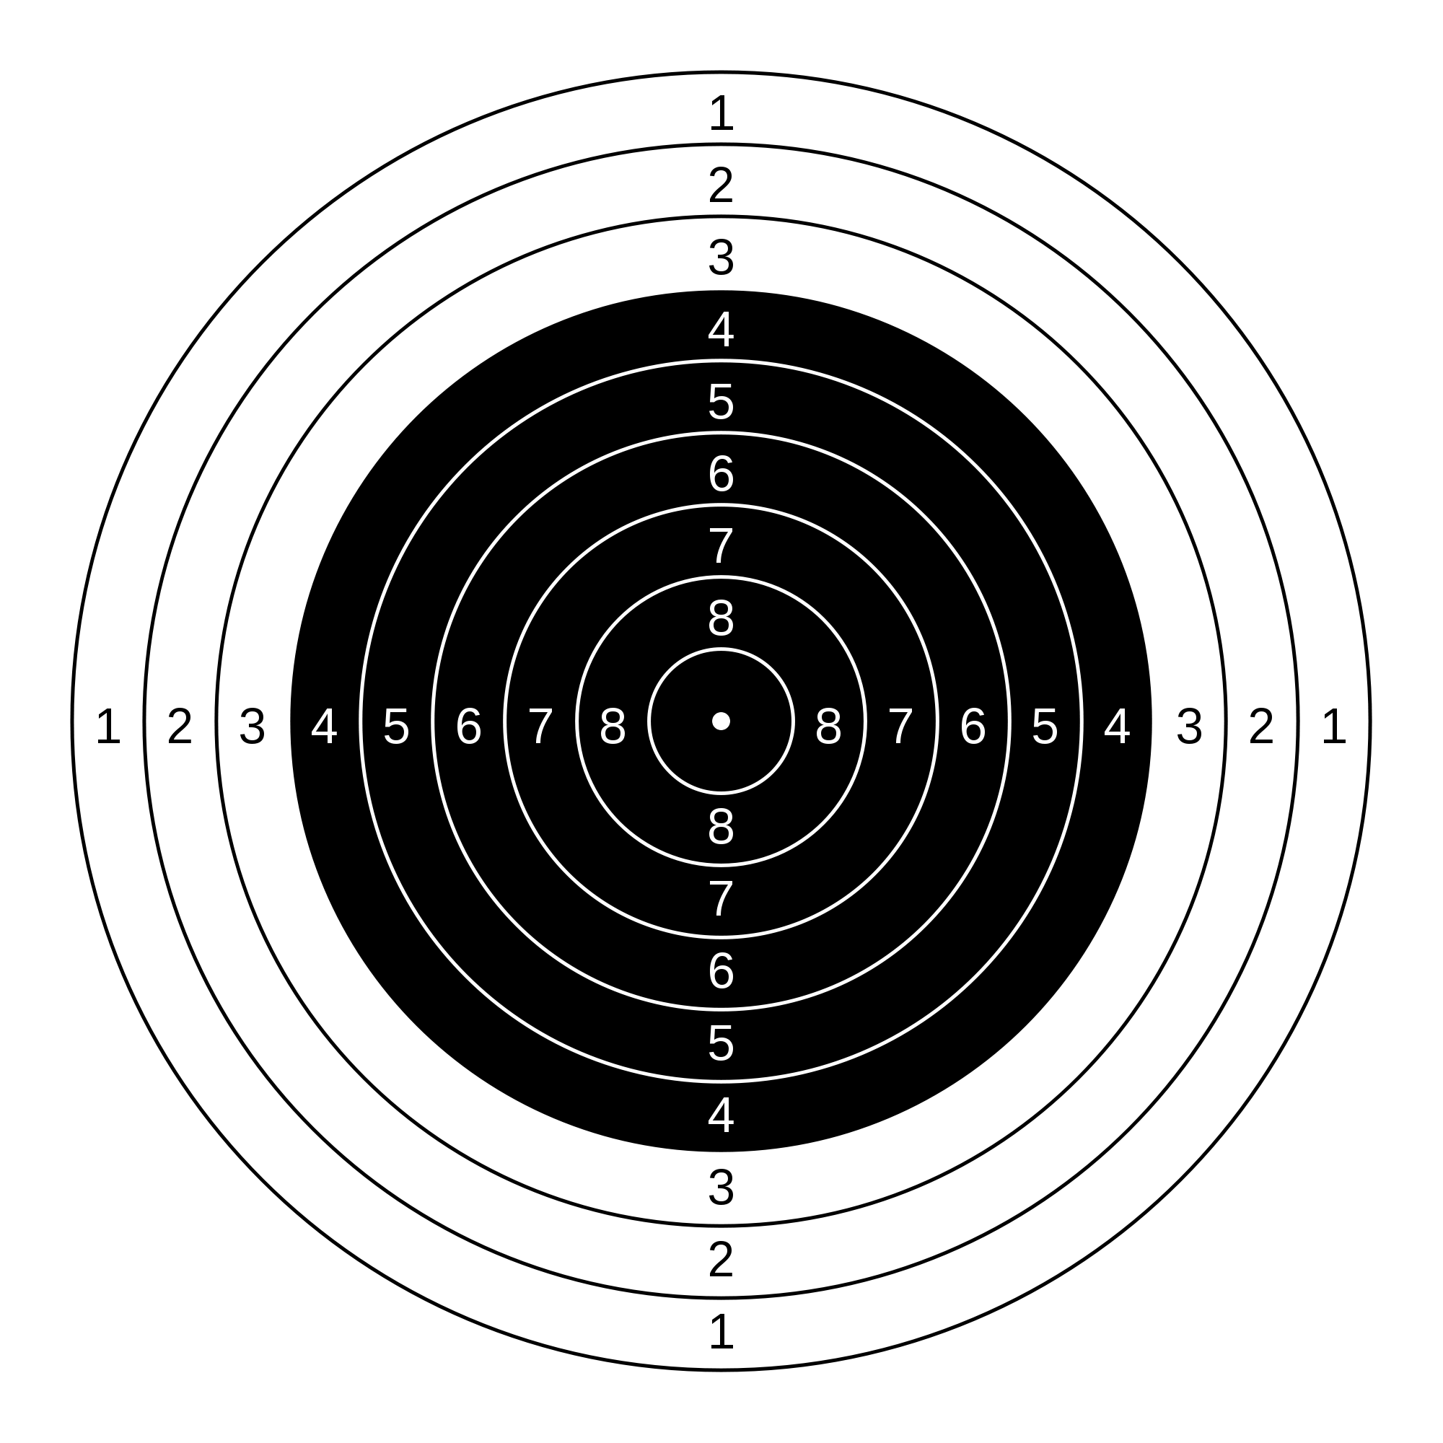

TARGET
Make 10

Slide 4
TARGET
1 + _____ = 10

Slide 5
TARGET
2 + _____ = 10

Slide 6
TARGET
3 + _____ = 10

Slide 7
TARGET
4 + _____ = 10

Slide 8
TARGET
5 + _____ = 10

Slide 9
TARGET
6 + _____ = 10

Slide 10
TARGET
7 + _____ = 10

Slide 11
TARGET
8 + _____ = 10

Slide 12
TARGET
9 + _____ = 10

Slide 13
TARGET
_____ + 1 = 10

Slide 14
TARGET
_____ + 2 = 10

Slide 15
TARGET
_____ + 3 = 10

Slide 16
TARGET
_____ + 4 = 10

Slide 17
TARGET
_____ + 5 = 10

Slide 18
TARGET
_____ + 6 = 10

Slide 19
TARGET
_____ + 7 = 10

Slide 20
TARGET
_____ + 8 = 10

Slide 21
TARGET
_____ + 9 = 10

Slide 22
TARGET
10 = 1 + _____

Slide 23
TARGET
10 = 2 + _____

Slide 24
TARGET
10 = 3 + _____

Slide 25
TARGET
10 = 4 + _____

Slide 26
TARGET
10 = 5 + _____

Slide 27
TARGET
10 = 6 + _____

Slide 28
TARGET
10 = 7 + _____

Slide 29
TARGET
10 = 8 + _____

Slide 30
TARGET
10 = 9 + _____

Slide 31
TARGET
10 = _____ + 1

Slide 32
TARGET
10 = _____ + 2

Slide 33
TARGET
10 = _____ + 3

Slide 34
TARGET
10 = _____ + 4

Slide 35
TARGET
10 = _____ + 5

Slide 36
TARGET
10 = _____ + 6

Slide 37
TARGET
10 = _____ + 7

Slide 38
TARGET
10 = _____ + 8

Slide 39
TARGET
10 = _____ + 9

